Slide 1
Rendezvous
Team Awesome

Slide 2

Features
Create Events
Make Scheduling Easy
Track Attendees
Send Messages to Group
Unique Profiles

Slide 3
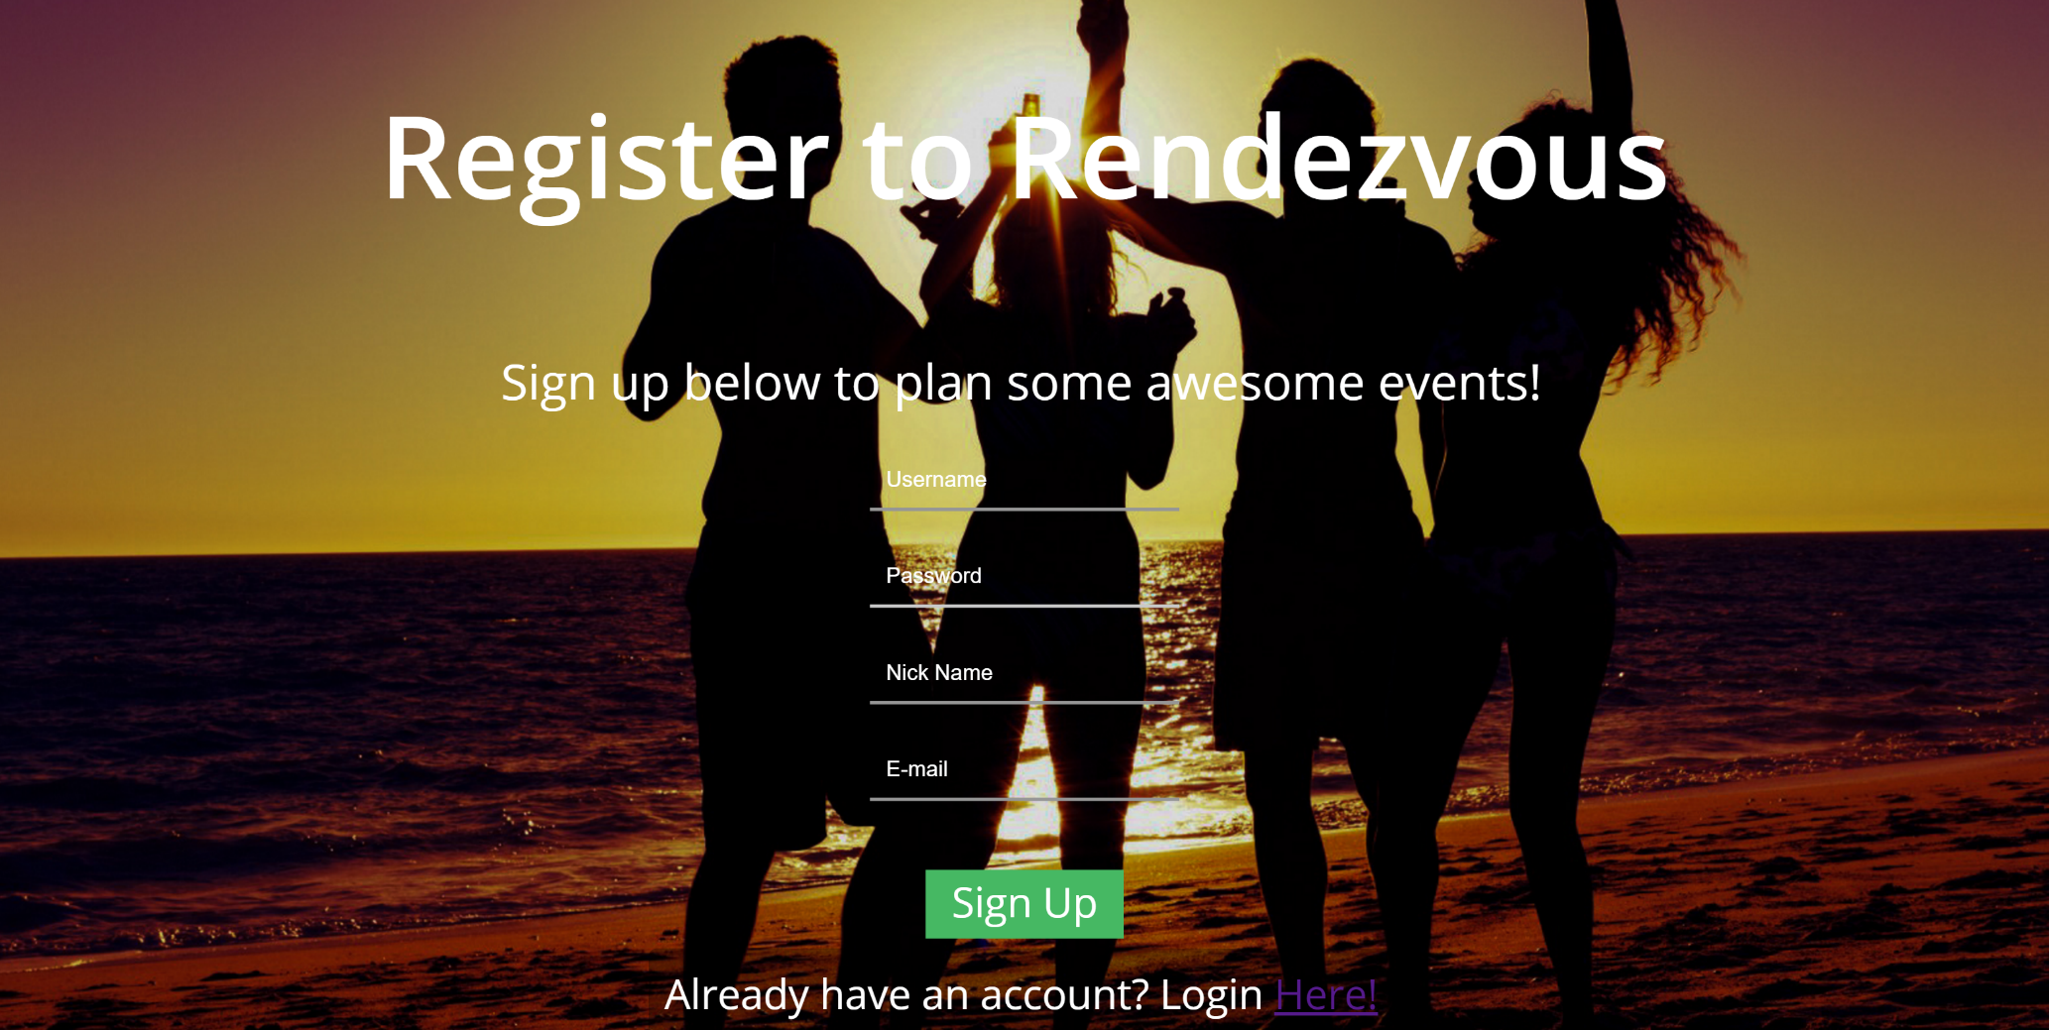
Website Integration
Allow you to manage account without having to take out phone.
Allows for better cross platform integration

Slide 4
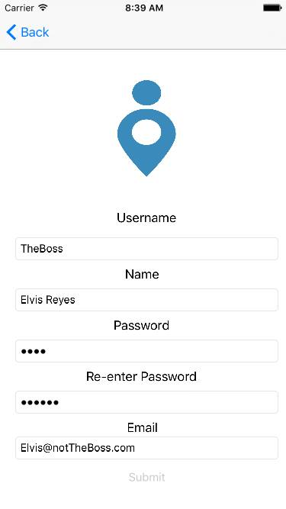
User Profiles
Upload a picture to allow easy recognition by others.
Manage events you are hosting and attending.
Change attending status
Allows for: Going, Not Going, and Maybe
Turn Location tracking on and off
Add friends using email

Slide 5
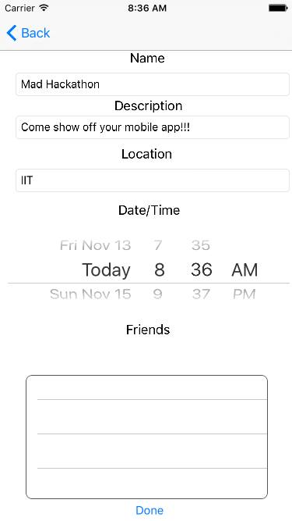
Events
Create custom events
Each event has its own: Name, Location, Description, Date and Time
Notify attendees on the day of the event
Give Host access to other people
One click invite friends and family
Real time tracking of attendees
Quickly locate people
Know how long it will take for user to arrive

Slide 6
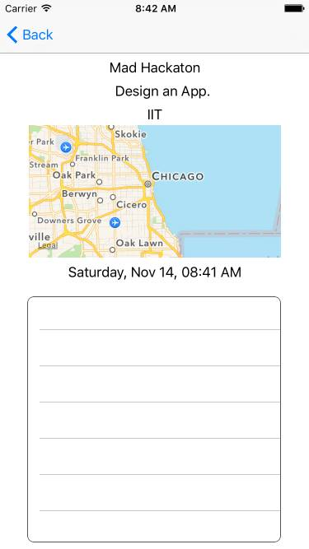
Tracking Attendees
Easily know when guest will arrive
Allows you to know how long you have to wait before you can start your meeting
Quickly locate event volunteers in large crowds.

Slide 7
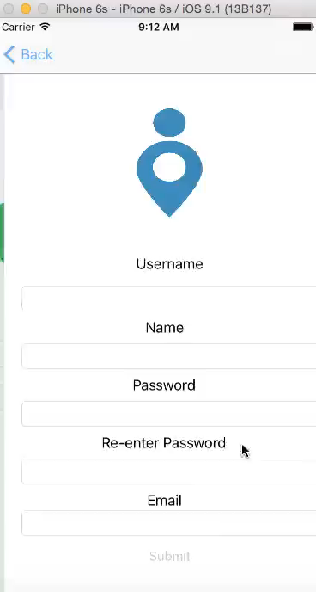
Demo Video

Slide 8
Moving Forward
Send Thank You messages after event
Group messaging
Notification when guest are near

